Slide 1
A project on Book Recommendation by
Mr. Varun Juluri
Mr. Ankit Sunil Bansal
Mr. Tejas Kulkarni
Mrs. Sonali Jagtap
Mrs Pyumori Deosthale
Mr. Sandeep Patil
Mr. Ganesh Samgir

Slide 2
ProblemDescription During the last few decades, with the rise of YouTube, Amazon, Netflix, and many other such web services, recommender systems have taken more and more place in our lives. From e-commerce (suggest to buyers articles that could interest them) to online advertisement (suggest to users the right contents, matching their preferences), recommender systems are today unavoidable in our daily online journeys. By analyzing the problems with ‘Book Recommendation System’ feature, how we can predict the best recommendation for users according to their items approach. A recommendation system helps an organization to create loyal customers and build trust by them desired products and services for which they came on your site. The recommendation system today is so powerful that they can handle the new customer too who has visited the site for the first time. They recommend the products which are currently trending or highly rated and they can also recommend the products which bring maximum profit to the company. Providing specific data analysis and prediction to done with this data. The main objective is to built a predictive recommender model, which could help in predicting – how we can predict the best recommendation for users according to their items approach. This would help us in providing better recommendation item to a right specific users.

Slide 3
Data Description:
We have three datasets:
●User:
User-ID, Location, Age
●Books:
ISBN ,Book-Title ,Book-Author, Year-Of-Publication, Publisher
Image-URL-S, Image-URL-M ,Image-URL-L
●Rating:
User-ID ,ISBN, Book-Rating

Slide 4
EDA
Users Shape:
(278858, 3)
Rating Shape:
(1048575, 3)
Books Shape:
(271360, 8)

Slide 5
Books Dataset
Shape :- (271360, 8)
Null values:- Book author = 1
Publisher = 2

Slide 6
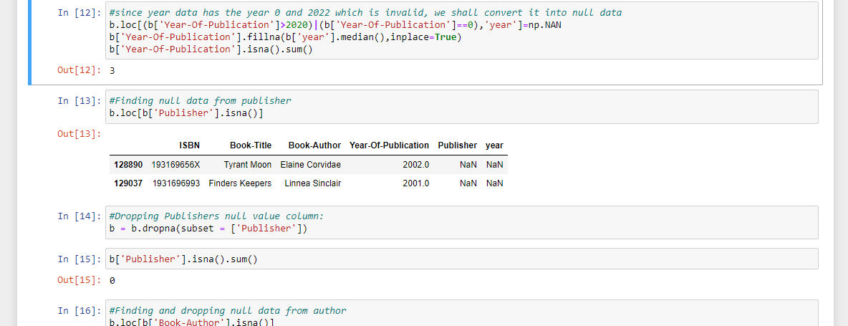
Work we done in Books dataset.
We droped the 3 columns which belongs to image url. Because, we don’t need them for analysis.
We changed the values of year of publication equals to 0 and above the 2020 as null.
We changed the null values to median values.
Droped the null values in both publisher and book author.

Slide 7
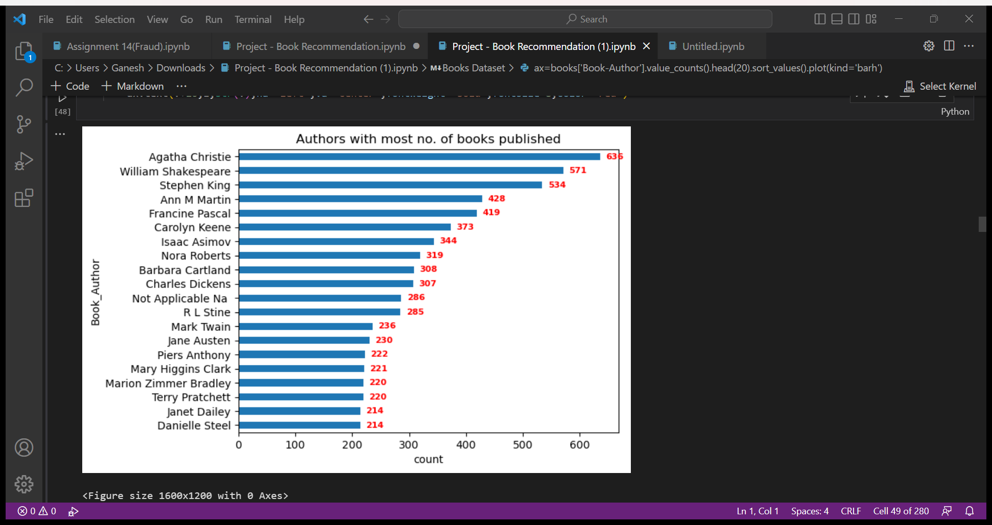
Visualization for Books Dataset
Authors with most number of books:
Agatha Christie is leading at top with more than 600 counts, followed by William Shakespeare.
2) William Shakespeare is one of the popular Author in the world. Still he doesn't have highest number of books.

Slide 8
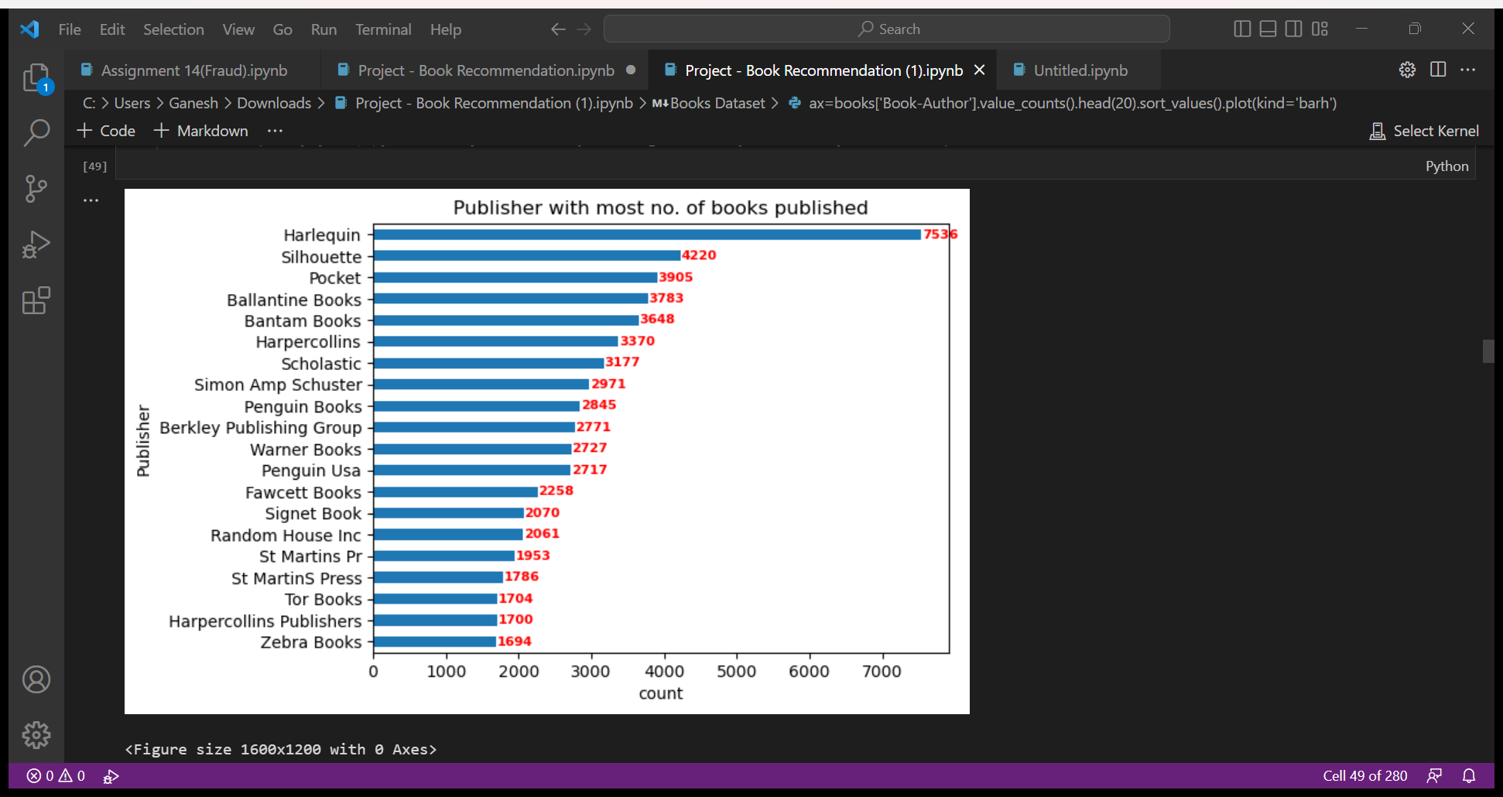
Publisher with most number of Books: 1) Harlequin has most number of books published, followed by Silhouette. 2) Some of the top Author's had published their books from Harlequin. 3) We can observe Harlequin publiser's marking better performance than any other publishers.

Slide 9
Ratings Dataset
Shape :- (1048575, 3)
Null values:- No null values

Slide 10
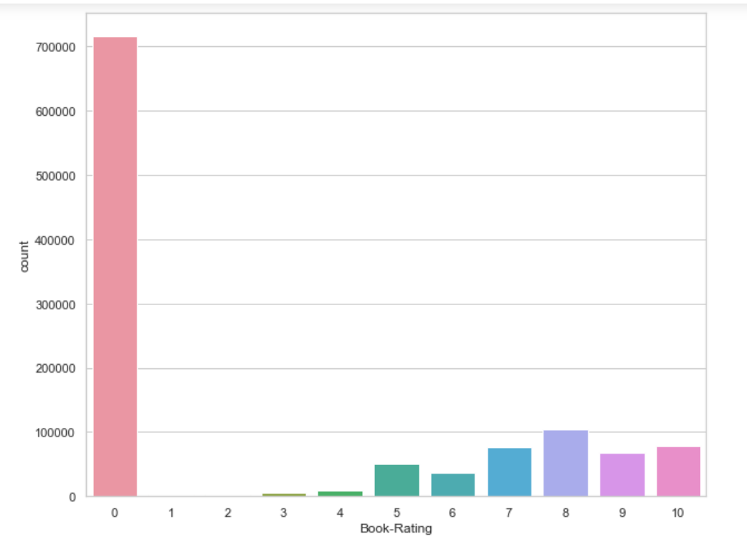
Visualizations for Ratings Dataset
Count of Book Ratings:
This countplot shows users have rated 0 the most, which means they haven't rated books at all.
2) Still we can see pattern to recognize in ratings from 1-10.
3) Mostly the users have rated 8 ratings out of 10 as per books. It might happen that the feedback is positive but not extremely positive as 10 ratings.

Slide 11
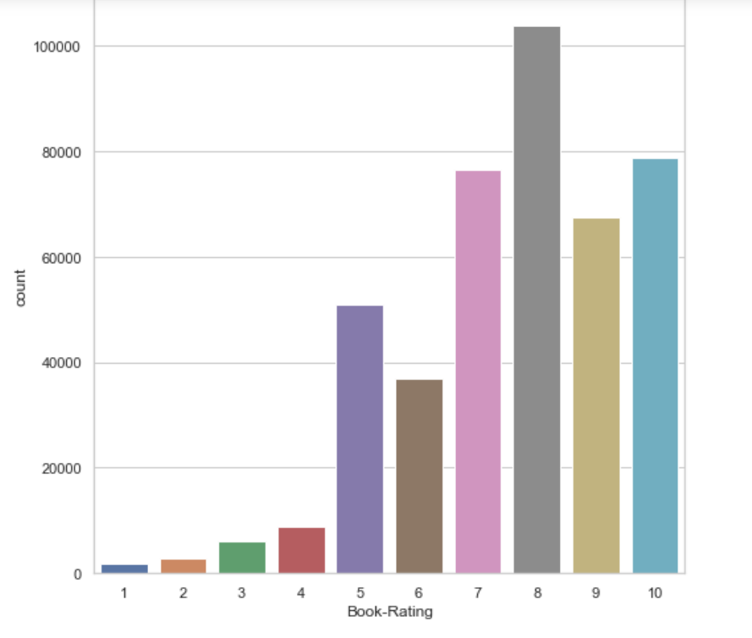
We have created Explicit Ratings to get the closer view to the Ratings Dataset, As many users have not rated at all. Countplot for Explicit Rating: 1) This countplot of bookRating indicates that higher ratings are more common amongst users and rating 8 has been rated highest number of times. 2) Let's take ratings group from 1-4. This can be negative impact for books been published if they have ratings from 1 to 4. 3) Let's take ratings group from 6-10. This are positive feedback. It can happen that not every book is perfect in all desire. So, the user's have decided to rate 8.

Slide 12
UsersDataset
Shape :- (278858, 3)
Null values:- Age = 110762

Slide 13
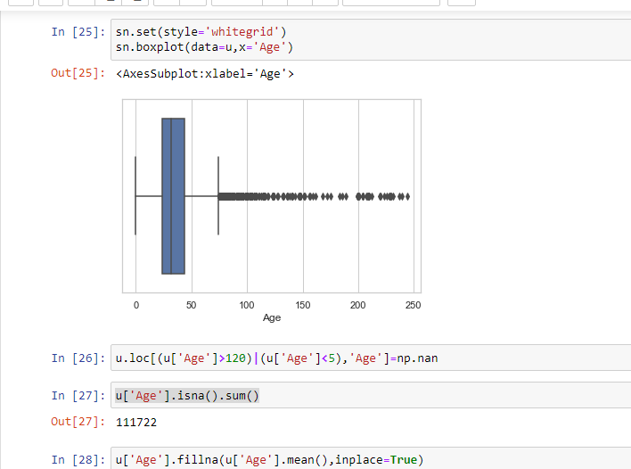
Work we done in User dataset.
We have done the boxplot of age column to detect outliers, as we have large number of null values.
Value count for age > 120 = 1130
We extracted Most famous publisher for age > 120 (Ballantine Book - 37)
Found Age which read books from this publisher (Age 33 - 1116)
Imputed the respective age value in-place of age over 120
Value count after imputation = 24
Extracted Most famous author for age>120 (Catherine coulter - 17)
Used same logic to impute the remaining values
Value count after imputation = 16
Still some values were left, so imputed them with median values for age >120

Slide 14
Work we done in User dataset.
Same logic is used for imputing the age value below 6
Remaining values for age<6 are imputed with median value for age between 6 to 20 i.e. teen age group
Null values are imputed in same manner. At last almost 20K values were remaining.
Those are imputed with median value for whole age feature

Slide 15
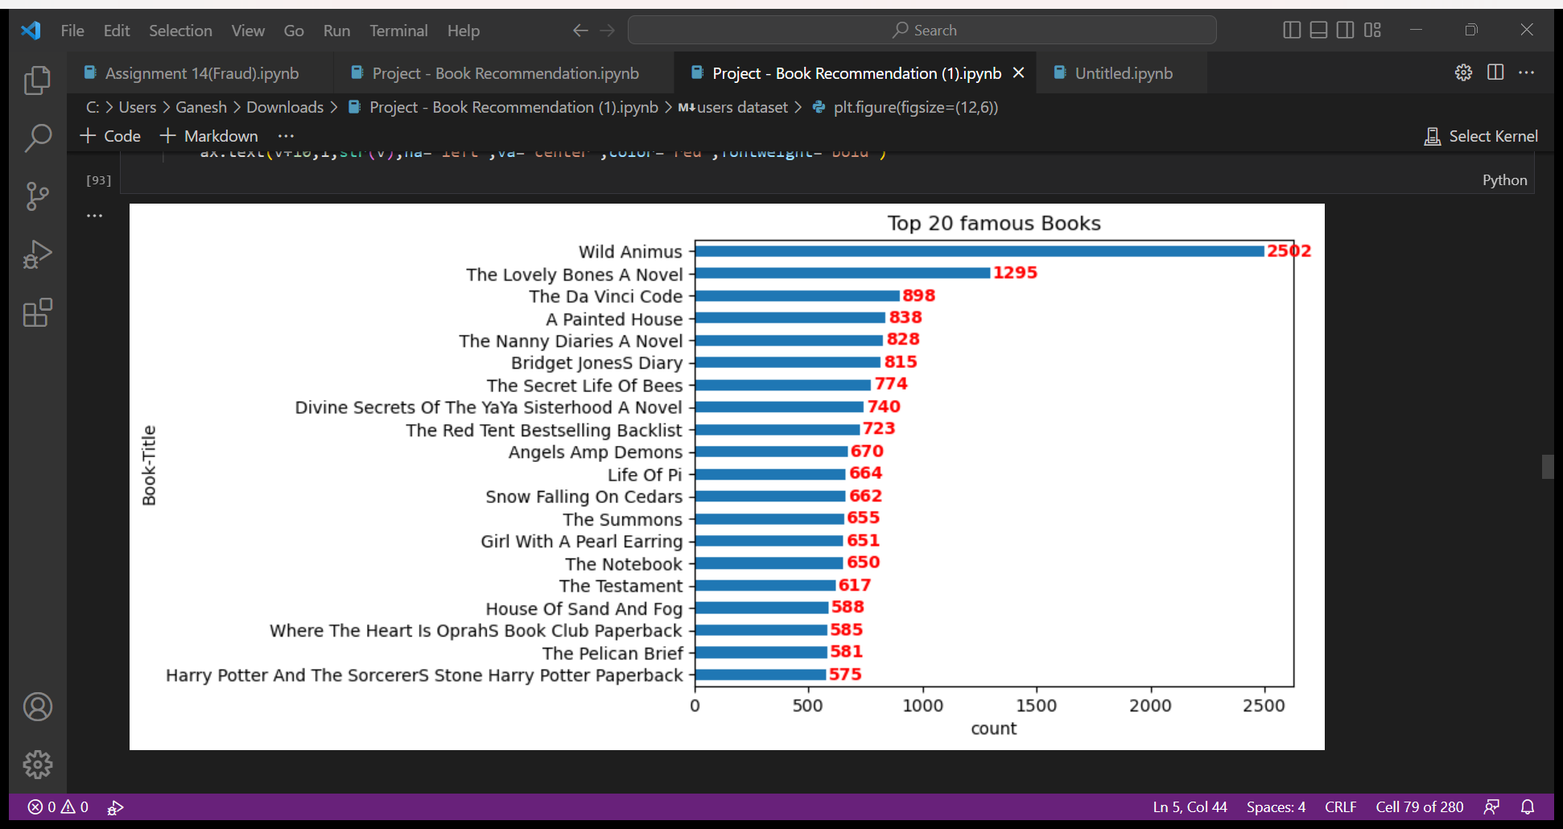
Merging of 3 datasets
We merged the three datasets and made the main dataset.
We have done the countplot of top 20 books according to their ratings.
As we can see in the countplot, ‘Wild Animus’ is the most rated book, leaving ‘The Lovely Bones A Novel’ and ‘The Da Vinci Code’ behind.

Slide 16
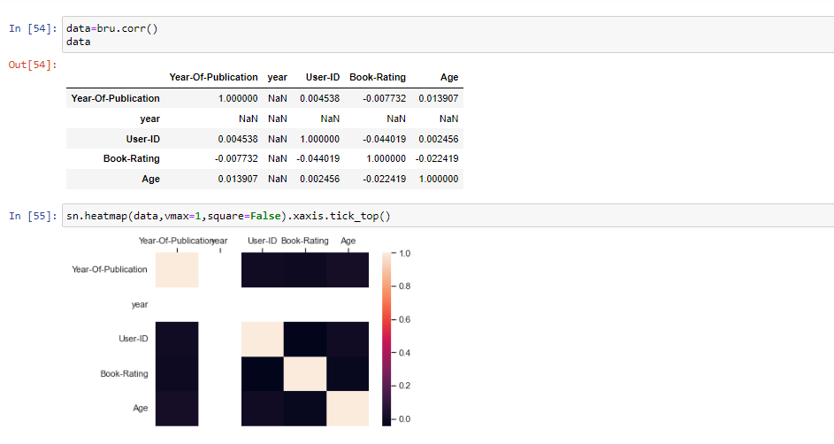
Co-Relation and Heatmap: we have performed correlation on the merged Dataset to get relations between several columns. We have also plotted the Heatmap of the same. Where the Dark scale means High correlation and light scale means less correlation.

Slide 17
Model Building
Popularity based model
Calculated average rating for all books
Determined the number of times each book rated
Then from master data, extracted books which are having average rating > 7 and rated for at least 10 times.
Such books are terminated as famous book.
These books can be recommended to early stage readers.

Slide 18
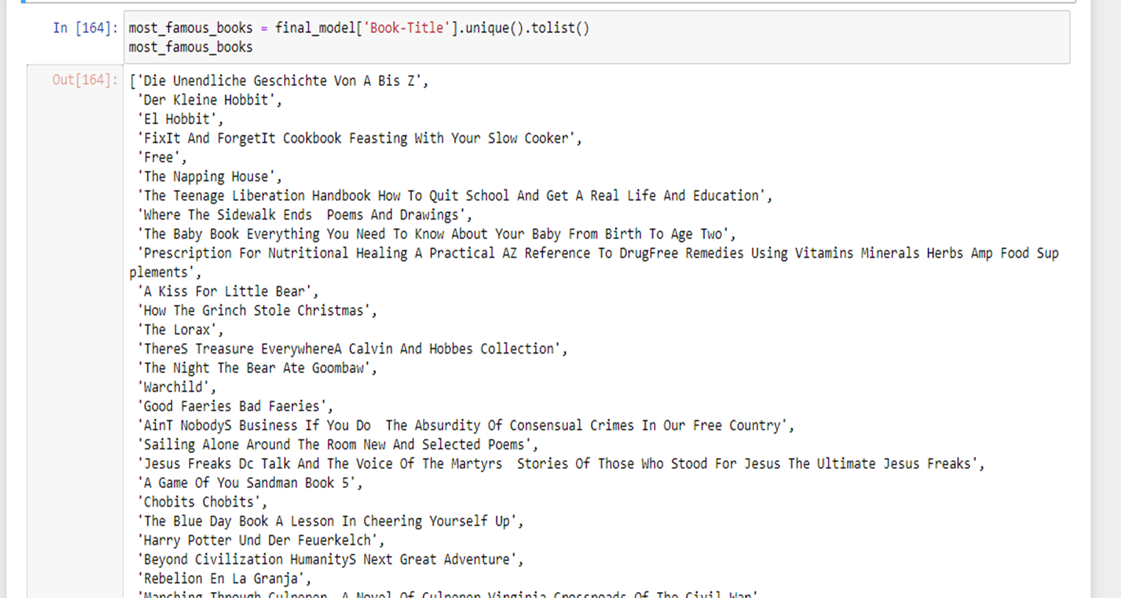
List of Most Famous Books

Slide 19
Rating based similarity model
From master data, eliminated records with rating 0.
Eliminated those users which has read less than 50 books.
Used cosine similarity to find similarity between two users.
Built a function to recommend books to particular users.
Determined top 5 similar users for one user.
Then extracted all books read by these 5 users.
Subtracted books read by one user from its top 5 similar users and recommended those books to that one user.

Slide 20
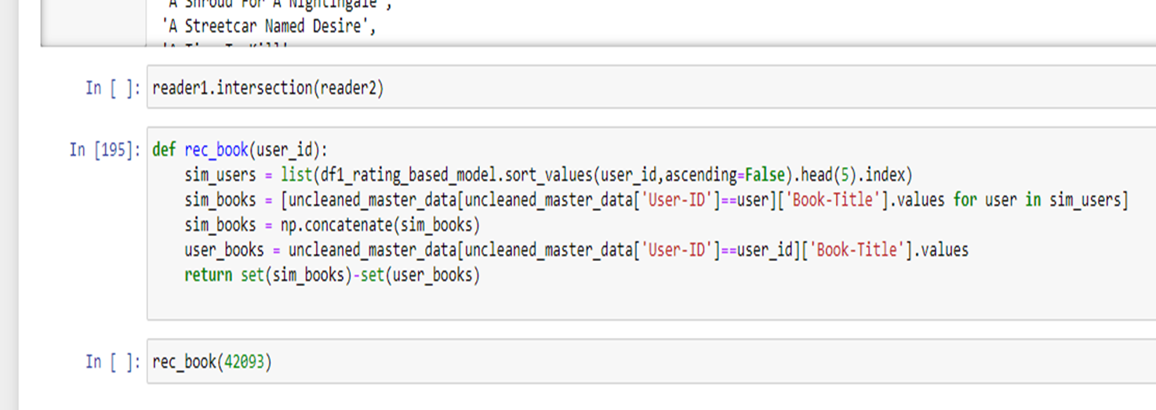
Rating based similarity model

Slide 21
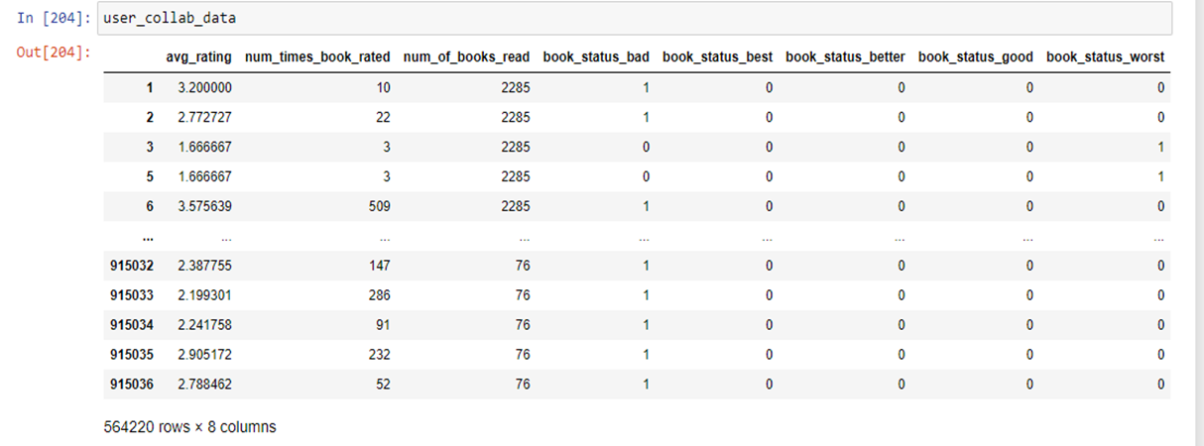
Memory based similarity model
A column ‘book-status’ added using rating (0-2 rating = worst book,
2-4=bad book, good , better, best)
From master data, took only ‘avg_rating’, ‘ num of times book rated‘, ’book status’, and ‘books read by user’ columns.

Slide 22
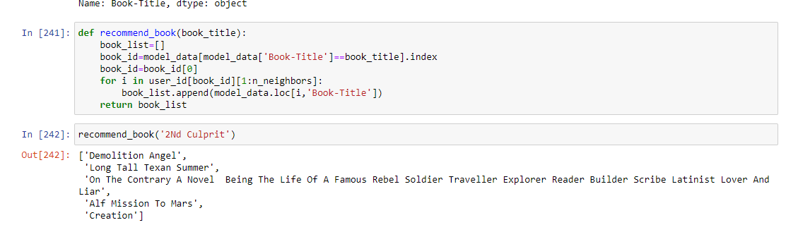
Memory based similarity model
Data is standardized and then used label encoder to convert book-status column.
Used nearest neighbors to find nearest readers (6 neighbors considered)
Then created function to recommend books depending upon book read.

Slide 23
Age based similarity model
Master data is sorted by age groups as follows
Teen :- (6-20 years) young :- (20-30 years)
adult :- (30-40 years) mature :- (40-60 years)
seniors :- (above 60 years)
Similar to rating based model, the values from pivot table are filled by age values.
Separate models are built for each age group
similar logic (cosine similarity) is used for this model to recommend books

Slide 24
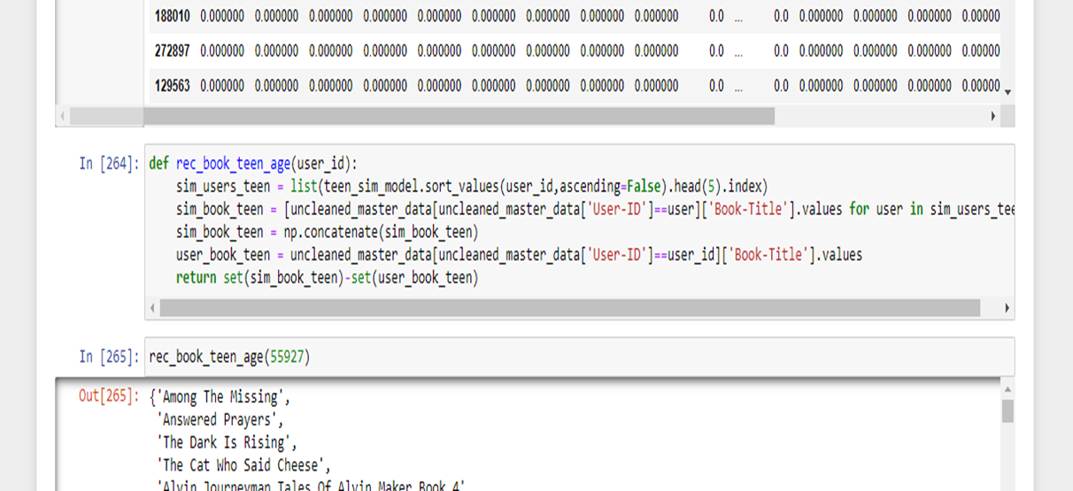
Rating based similarity model

Slide 25
Challenges encountered / learnings
Cold start problem - Not having sufficient data with respect to few readers.
Found many null values in age column so made considerable amount of imputation based on some assumptions.
Age feature had many non-sense data. So made imputation for the same.
As data for few users were missing, so merged all datasets only on common rows from all datasets.
While model building, eliminated users with rating “zero” as similarity model is not able to deal with it.
Worked as team and break things in small which made proceedings easier.

Slide 26
Conclusions
Three datasets were given. Performed EDA on each dataset separately.
Imputed non-sense data as well as null values from Features.
Merged all datasets based on common values from all.
Created a list of most famous books for recommending it to early stage readers.
Created a model for recommendation based on previously read book by reader
Using cosine similarity, build model using rating and age values.
Separate models are build to recommend books based on age groups.

Slide 27
Thank you

